Slide 1
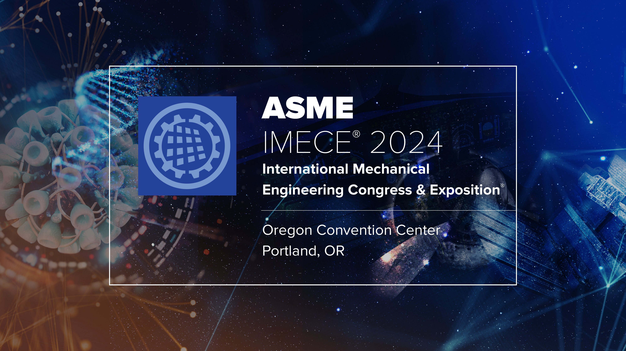
Notes:
Hello, and thank you everyone for coming to this presentation.

Slide 2

ANALYSIS AND SIMULATION OF TWO-DIMENSIONAL DUAL-ARM MANIPULATOR FOR BASEBALL TRAINING
IMECE2024-141597
Kyler Limata, Qinfu Hu, Dr. Shawn Duan
Mechanical Engineering Department
Hal and Inge Marcus School of Engineering
Saint Martin’s University
Lacey, WA 98503
Notes:
My name is Kyler Limata, I am a master’s of mechanical engineering student at Saint Martin’s University, and I will be presenting the paper “ANALYSIS AND SIMULATION OF TWO-DIMENSIONAL DUAL-ARM MANIPULATOR FOR BASEBALL TRAINING”. This paper was written by myself and my partner Qinfu Hu with assistance from our faculty advisor Dr. Shawn Duan. Unfortunately, Qinfu could not be here today, so I will be the only presenting author.

Slide 3
Outline
Introduction
Theory and Procedure
Kinematics
Equations of Motion
Kane’s Method
Results and Discussion
Conclusions
Notes:
This presentation is broken down into four sections, starting with a brief introduction to the project. The second section will cover the theory and procedure, which includes the kinematics of the arm, the derivation of the equations of motion, and finally calculating the forces on the arm using Kane’s Method. We will then cover the simulation of the arm and discuss its results, finishing with a brief conclusion.

Slide 4
Introduction
Goal: Simulate a 2D robot arm as a 2-link dynamic body with torques applied to joints
Reason: Further research towards an arm for training baseball players
Simulation: MATLAB script generated from AutoLev software package
Notes:
The goal of this project was to simulate a 2D, 2-link robot arm that we would then test the response of by applying differing torques to both joints. Our hope is that the results of this project – despite its preliminary nature – will spark further research into robot arms for pitching baseballs to train baseball players. To develop the equations of motion, we used Autolev, which is a domain specific language for performing linear algebra, kinematic, and dynamics calculations; Autolev was also used to generate a MATLAB script for simulating the arm that otherwise would have been time consuming to write by hand.

Slide 5
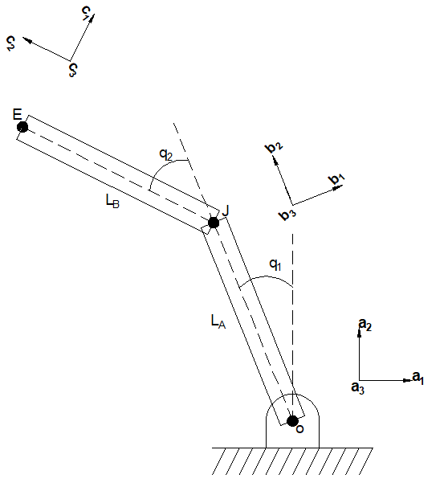
Theory and Procedure: Kinematics
Simple, two-link model
End-gripper omitted
Coordinate Axes
Notes:
As discussed on the prior slide, the kinematic model of the arm consists of two links and points O, J, and E, where O is fixed. Since it was not the focus of this project, the end effector was omitted to produce a simpler model. If you look at the graphic, you’ll also note 3 sets of coordinate axis, a, b, and c.

Slide 6
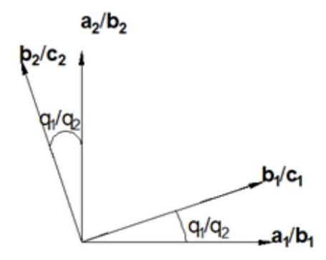
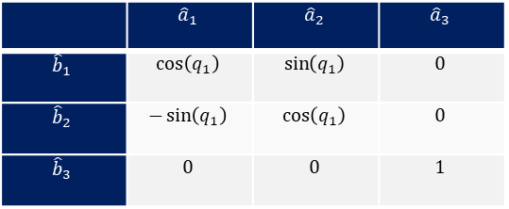
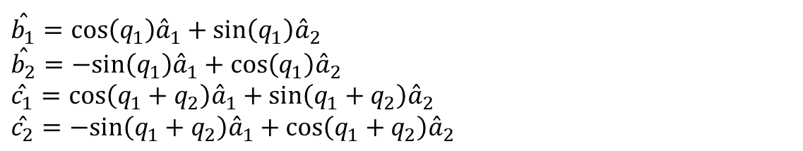
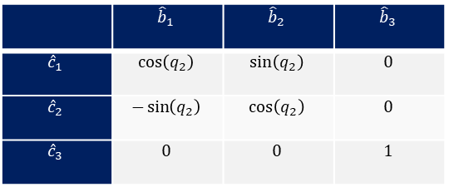
Theory and Procedure: Kinematics
Relationship between reference frames
 | $${\hat{a}}_{1}$$ | $${\hat{a}}_{2}$$ | $${\hat{a}}_{3}$$
$${\hat{b}}_{1}$$ | $$\cos\left(q_{1}\right)$$ | $$\sin\left(q_{1}\right)$$ | $$0$$
$${\hat{b}}_{2}$$ | $$−\sin\left(q_{1}\right)$$ | $$\cos\left(q_{1}\right)$$ | $$0$$
$${\hat{b}}_{3}$$ | $$0$$ | $$0$$ | $$1$$
 | $${\hat{b}}_{1}$$ | $${\hat{b}}_{2}$$ | $${\hat{b}}_{3}$$
$${\hat{c}}_{1}$$ | $$\cos\left(q_{2}\right)$$ | $$\sin\left(q_{2}\right)$$ | $$0$$
$${\hat{c}}_{2}$$ | $$−\sin\left(q_{2}\right)$$ | $$\cos\left(q_{2}\right)$$ | $$0$$
$${\hat{c}}_{3}$$ | $$0$$ | $$0$$ | $$1$$
$$\overset{ˆ}{b_{1}}=cos⁡\left(q_{1}\right){\overset{ˆ}{a}}_{1}+sin⁡\left(q_{1}\right){\overset{ˆ}{a}}_{2}$$
$$\overset{ˆ}{b_{2}}=−sin⁡\left(q_{1}\right){\overset{ˆ}{a}}_{1}+cos⁡\left(q_{1}\right){\overset{ˆ}{a}}_{2}$$
$$\overset{ˆ}{c_{1}}=cos⁡\left(q_{1}+q_{2}\right){\overset{ˆ}{a}}_{1}+sin⁡\left(q_{1}+q_{2}\right){\overset{ˆ}{a}}_{2}$$
$$\overset{ˆ}{c_{2}}=−sin⁡\left(q_{1}+q_{2}\right){\overset{ˆ}{a}}_{1}+cos⁡\left(q_{1}+q_{2}\right){\overset{ˆ}{a}}_{2}$$
Notes:
These correspond to the reference frames a, b, and c of points O, J, and E, where a is Newtonian. Deriving the equations of motion requires transforming the velocities and accelerations of J and E from frames b and c into a. This graphic shows that the relationship between each frame is a simple rotation, which corresponds to the rotation matrices shown here. Using these, the unit vectors of b and c can be redefined in terms of the unit vectors of a. Note that a3, b3, and c3 always point in the same direction, making them equivalent. Q1 and q2 here represent the generalized coordinates of the system – in this case, they are the angles of each link with respect to the reference frame of their base point.

Slide 7
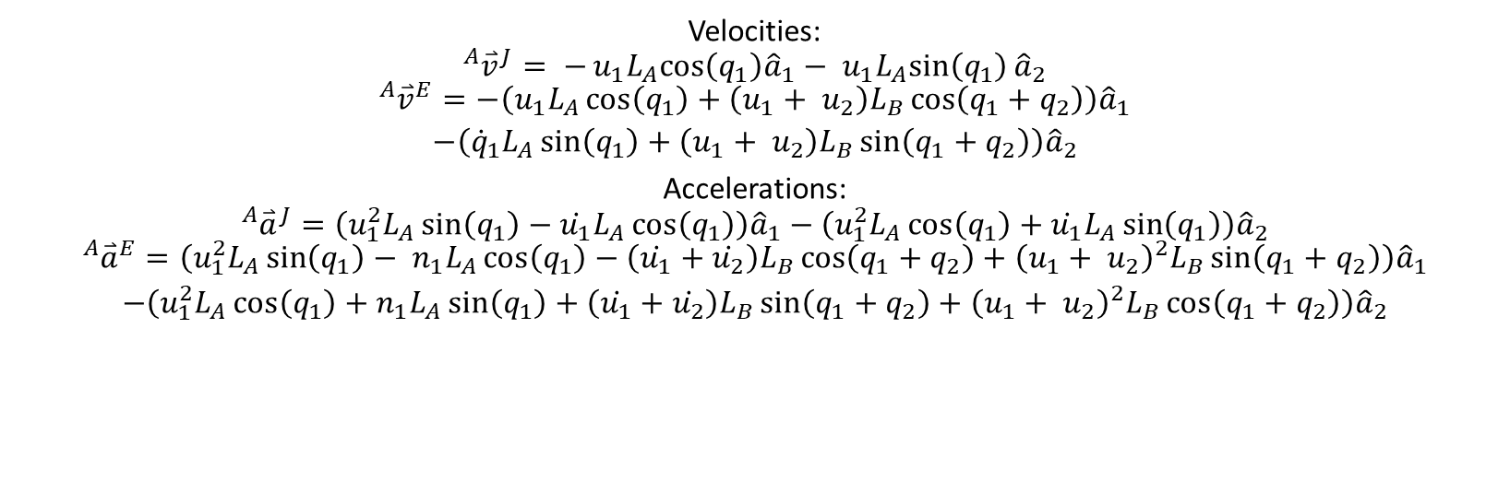
Theory and Procedure: Kinematics
Velocities:
$$\begin{aligned}{}_{ }^{A}{{\overset{⃑}{v}}^{J}}= −u_{1}L_{A}cos\left(q_{1}\right){\hat{a}}_{1}− u_{1}L_{A}sin\left(q_{1}\right){\hat{a}}_{2}\end{aligned}$$
$$\begin{aligned}{}_{ }^{A}{{\overset{⃑}{v}}^{E}}=−\left(u_{1}L_{A}\cos\left(q_{1}\right)+\left(u_{1}+ u_{2}\right)L_{B}\cos\left(q_{1}+q_{2}\right)\right){\hat{a}}_{1} \\ −\left({\dot{q}}_{1}L_{A}\sin\left(q_{1}\right)+\left(u_{1}+ u_{2}\right)L_{B}\sin\left(q_{1}+q_{2}\right)\right){\hat{a}}_{2}\end{aligned}$$
Accelerations:
$$\begin{aligned}{}_{ }^{A}{{\overset{⃑}{a}}^{J}}=\left(u_{1}^{2}L_{A}\sin\left(q_{1}\right)−\dot{u_{1}}L_{A}\cos\left(q_{1}\right)\right){\hat{a}}_{1}−\left(u_{1}^{2}L_{A}\cos\left(q_{1}\right)+\dot{u_{1}}L_{A}\sin\left(q_{1}\right)\right){\hat{a}}_{2}\#\end{aligned}$$
$$\begin{aligned}{}_{ }^{A}{{\overset{⃑}{a}}^{E}}=\left(u_{1}^{2}L_{A}\sin\left(q_{1}\right)− n_{1}L_{A}\cos\left(q_{1}\right)−\left(\dot{u_{1}}+\dot{u_{2}}\right)L_{B}\cos\left(q_{1}+q_{2}\right)+{\left(u_{1}+ u_{2}\right)}^{2}L_{B}\sin\left(q_{1}+q_{2}\right)\right){\hat{a}}_{1} \\ −\left(u_{1}^{2}L_{A}\cos\left(q_{1}\right)+n_{1}L_{A}\sin\left(q_{1}\right)+\left(\dot{u_{1}}+\dot{u_{2}}\right)L_{B}\sin\left(q_{1}+q_{2}\right)+{\left(u_{1}+ u_{2}\right)}^{2}L_{B}\cos\left(q_{1}+q_{2}\right)\right){\hat{a}}_{2}\#\end{aligned}$$
Notes:
Using the two-point formula and the rotation matrices established in the previous slide, we were able to compute the linear velocity and acceleration of points J and E with respect to point O and reference frame a. U1 and u2 are the generalized velocities of the system, which are the radial velocities of each link. We checked these equations by performing hand calculations as well to make sure that they were correct.

Slide 8

Theory and Procedure: Kane’s Equations
Generalized Active and Inertial Forces
Forces w.r.t. each degree of freedom
Moment of Intertia + Equations of Motion
$$F_{r}+F_{r}^{∗}=0$$
$$F_{r}=\sum_{k=1}^{N}{ } \left({\vec{ω}}_{r}^{B_{k}}⋅{\vec{T}}_{r}^{B_{k}}+{\vec{v}}_{r}^{B_{k}}⋅{\vec{R}}_{r}^{B_{k}}\right)$$
$$F_{r}^{∗}=\sum_{k=1}^{N}{ } \left({\vec{ω}}_{r}^{B_{k}}⋅{\vec{T}}_{r}^{B_{k}^{∗}}+{\vec{v}}_{r}^{B_{k}}⋅{\vec{R}}_{r}^{B_{k}^{∗}}\right)$$
$${\vec{R}}_{r}^{B_{k}^{∗}}=m^{B_{k}}{\vec{a}}^{B_{k}}$$
$${\vec{T}}_{r}^{B_{k}^{∗}}=−{\vec{\vec{I}}}^{B_{k}^{∗}}⋅{\vec{a}}^{B_{k}}−{\vec{ω}}_{r}^{B_{k}}×\left(\vec{\vec{I}}B_{k}^{∗}⋅{\vec{ω}}_{r}^{B_{k}}\right)$$
Notes:
Kane’s Method is a series of equations for finding the generalized active and inertial forces on a rigid body, Fr and Fr star respectively. R here represents a single degree of freedom for the system – in the case of the arm, the first degree of freedom is the rotation of the first link about O and the second is the rotation of the second link about J. Solving for Kane’s Equations requires the equations of motion and the moments of inertia of each body in the system.

Slide 9
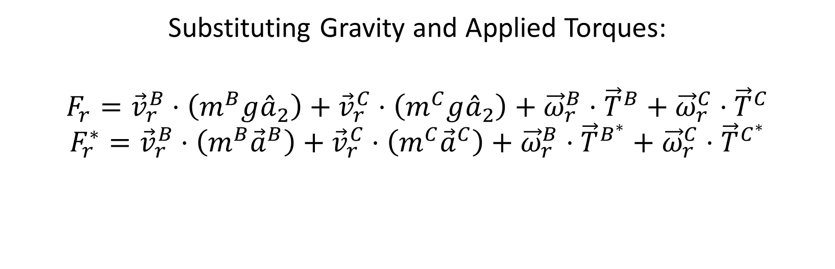
Theory and Procedure: Kane’s Equations
Substituting Gravity and Applied Torques:
$$F_{r}={\vec{v}}_{r}^{B}⋅\left(m^{B}g{\overset{ˆ}{a}}_{2}\right)+{\vec{v}}_{r}^{C}⋅\left(m^{C}g{\overset{ˆ}{a}}_{2}\right)+{\vec{ω}}_{r}^{B}⋅{\vec{T}}^{B}+{\vec{ω}}_{r}^{C}⋅{\vec{T}}^{C}$$
$$F_{r}^{∗}={\vec{v}}_{r}^{B}⋅\left(m^{B}{\vec{a}}^{B}\right)+{\vec{v}}_{r}^{C}⋅\left(m^{C}{\vec{a}}^{C}\right)+{\vec{ω}}_{r}^{B}⋅{\vec{T}}^{B^{∗}}+{\vec{ω}}_{r}^{C}⋅{\vec{T}}^{C^{∗}}$$
Notes:
If we substitute gravity and the applied torques about the joints into the equations on the previous slide, we get the following equations for Fr and Fr star. Note that gravity only appears in the equation for the active forces.

Slide 10
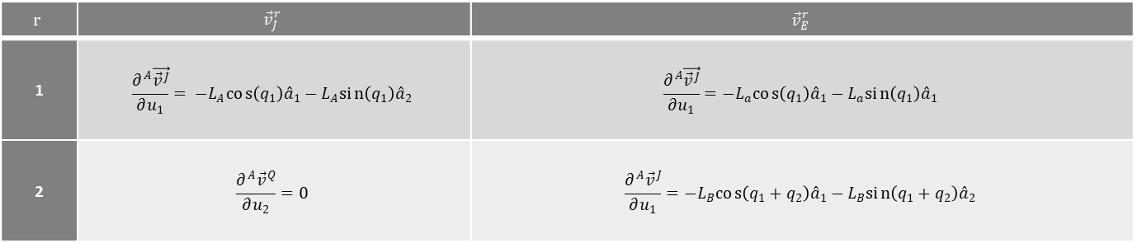

Theory and Procedure: Partial Velocities
$$r$$ | $${\vec{v}}_{J}^{r}$$ | $${\vec{v}}_{E}^{r}$$
1 | $$\frac{∂^{A}\vec{{\vec{v}}^{J}}}{∂u_{1}}= −L_{A}cos\left(q_{1}\right){\overset{ˆ}{a}}_{1}−L_{A}sin\left(q_{1}\right){\overset{ˆ}{a}}_{2}$$ | $$\frac{∂^{A}\vec{{\vec{v}}^{J}}}{∂u_{1}}=−L_{a}cos\left(q_{1}\right){\overset{ˆ}{a}}_{1}−L_{a}sin\left(q_{1}\right){\overset{ˆ}{a}}_{1}$$
2 | $$\frac{∂^{A}{\vec{v}}^{Q}}{∂u_{2}}=0$$ | $$\frac{∂^{A}{\vec{v}}^{J}}{∂u_{1}}=−L_{B}cos\left(q_{1}+q_{2}\right){\overset{ˆ}{a}}_{1}−L_{B}sin\left(q_{1}+q_{2}\right){\overset{ˆ}{a}}_{2}$$
$$r$$ | $${\vec{ω}}_{J}^{r}$$ | $${\vec{ω}}_{E}^{r}$$
1 | $$\frac{∂^{A}{\vec{ω}}^{B}}{∂u_{1}}={\overset{ˆ}{a}}_{3}$$ | $$\frac{∂^{A}{\vec{ω}}^{C}}{∂u_{1}}={\overset{ˆ}{a}}_{3}$$
2 | $$\frac{∂^{A}{\vec{ω}}^{B}}{∂u_{2}}=0$$ | $$\frac{∂^{A}{\vec{ω}}^{C}}{∂u_{2}}={\overset{ˆ}{a}}_{3}$$
Notes:
Since Kane’s Equations are computed with respect to each degree of freedom, the partial velocities with respect to each degree of freedom – both linear and angular – need to be computed. We do that by taking the partial derivatives of each with respect to each generalized velocity. This first table shows the partial linear velocities and this second table the partial angular velocities.

Slide 11
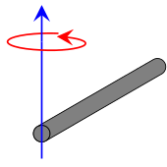
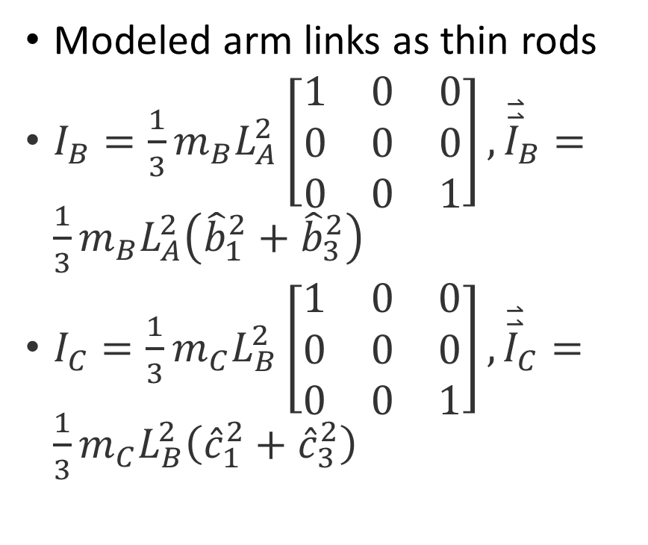
Theory and Procedure: Moment of Inertia
Modeled arm links as thin rods
$I_{B}=\frac{1}{3}m_{B}L_{A}^{2}\left[\begin{matrix}1 & 0 & 0 \\ 0 & 0 & 0 \\ 0 & 0 & 1\end{matrix}\right],{\overset{⃑}{\overset{⃑}{I}}}_{B}=\frac{1}{3}m_{B}L_{A}^{2}\left({\hat{b}}_{1}^{2}+{\hat{b}}_{3}^{2}\right)$
$I_{C}=\frac{1}{3}m_{C}L_{B}^{2}\left[\begin{matrix}1 & 0 & 0 \\ 0 & 0 & 0 \\ 0 & 0 & 1\end{matrix}\right],{\overset{⃑}{\overset{⃑}{I}}}_{C}=\frac{1}{3}m_{C}L_{B}^{2}\left({\hat{c}}_{1}^{2}+{\hat{c}}_{3}^{2}\right)$
Notes:
To simplify the overall calculations, it was decided to treat each of the links as thin rods with uniform density. The inertial tensors for each link are shown here, along with the corresponding dyadic form in the frame b and c respectively. Note that these are the moments of inertia of link 1 about J and link 2 about E.

Slide 12
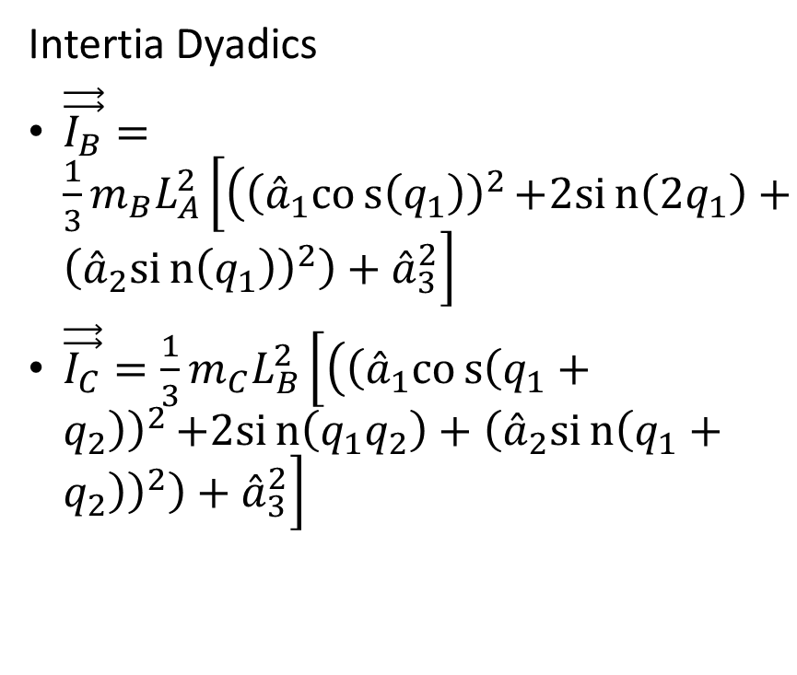
Theory and Procedure: Moment of Inertia
Intertia Dyadics
$\vec{\vec{I_{B}}}=\frac{1}{3}m_{B}L_{A}^{2}\left[\left({\left({\overset{ˆ}{a}}_{1}cos\left(q_{1}\right)\right)}^{2}\right.\right.\left.\left.+2sin\left(2q_{1}\right)+{\left({\overset{ˆ}{a}}_{2}sin\left(q_{1}\right)\right)}^{2}\right)+{\overset{ˆ}{a}}_{3}^{2}\right]$
$\vec{\vec{I_{C}}}=\frac{1}{3}m_{C}L_{B}^{2}\left[\left({\left({\overset{ˆ}{a}}_{1}cos\left(q_{1}+q_{2}\right)\right)}^{2}\right.\right.\left.\left.+2sin\left(q_{1}q_{2}\right)+{\left({\overset{ˆ}{a}}_{2}sin\left(q_{1}+q_{2}\right)\right)}^{2}\right)+{\overset{ˆ}{a}}_{3}^{2}\right]$
Notes:
Using the previously established rotation matrices and the sum difference identity in, we arrive at these equations for the inertial dyadic of each body respectively in terms of frame a.

Slide 13
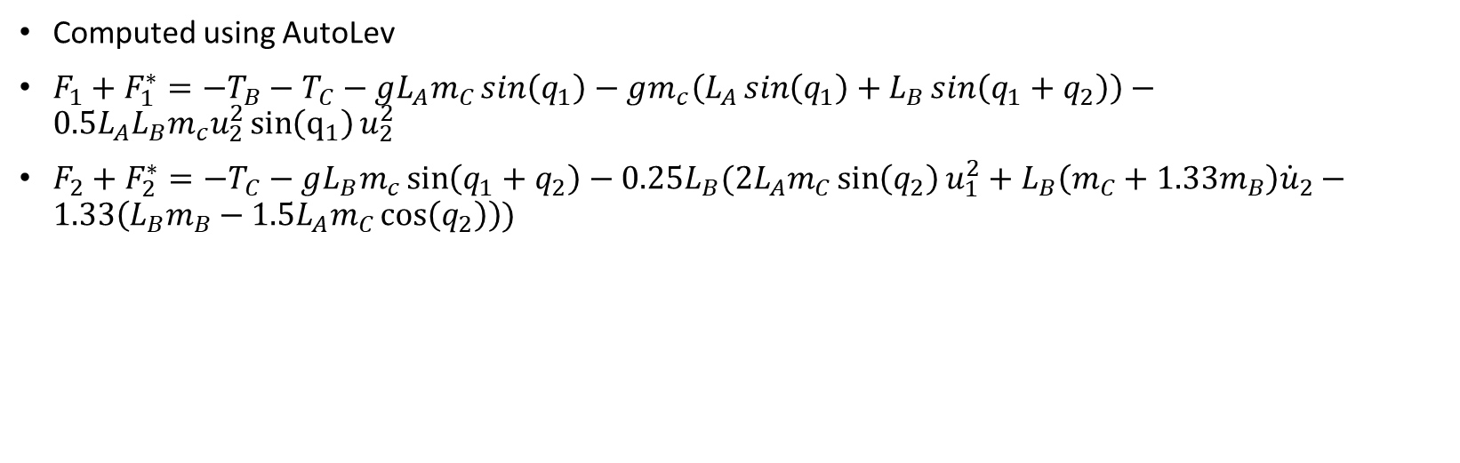
Theory and Procedure: Kane’s Equations
Computed using AutoLev
$F_{1}+F_{1}^{∗}=−T_{B}−T_{C}−gL_{A}m_{C}\sin\left(q_{1}\right)−gm_{c}\left(L_{A}\sin\left(q_{1}\right)+L_{B}\sin\left(q_{1}+q_{2}\right)\right)−0.5L_{A}L_{B}m_{c}u_{2}^{2}\sin\left(q_{1}\right)u_{2}^{2}$
$F_{2}+F_{2}^{∗}=−T_{C}−gL_{B}m_{c}\sin\left(q_{1}+q_{2}\right)−0.25L_{B}(2L_{A}m_{C}\sin\left(q_{2}\right)u_{1}^{2}+L_{B}\left(m_{C}+1.33m_{B}\right){\dot{u}}_{2}−1.33\left(L_{B}m_{B}−1.5L_{A}m_{C}\cos\left(q_{2}\right)\right))$
Notes:
The moments of inertia and the partial velocities can now be used to solve Kane’s equations for each degree of freedom. We did attempt to perform these calculations by hand but ran into issues with simplifying the equations due to their length, so we relied on AutoLev to find the equations you see here.

Slide 14
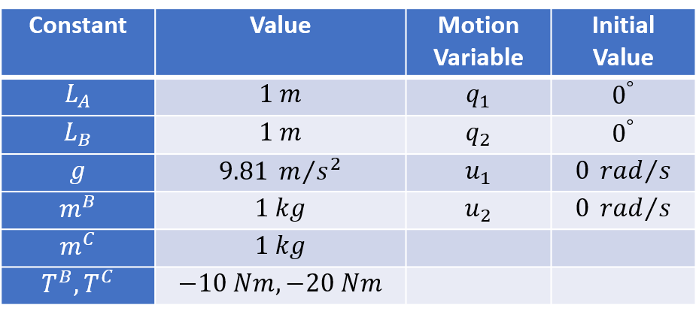
Simulation and Results: Overview
Simple simulation due to time constraints
Varying torque applied to both joints
0.5 second simulation time
Notes:
Now, on to the simulation. Due to the time constraints on this project, we were only able to perform a simple simulation where we applied different torques to each joint. A half second simulation time was selected as any longer would lead to the links performing multiple revolutions. This table shows the different simulation constants – namely the masses and lengths of the link – as well as the initial values of the motion variables. Note that the arm starts upright and at rest. A total of four simulations were conducted with the torque about each joint being either -10 Nm or -20 Nm, which is to say 10 or 20 Nm counterclockwise.

Slide 15
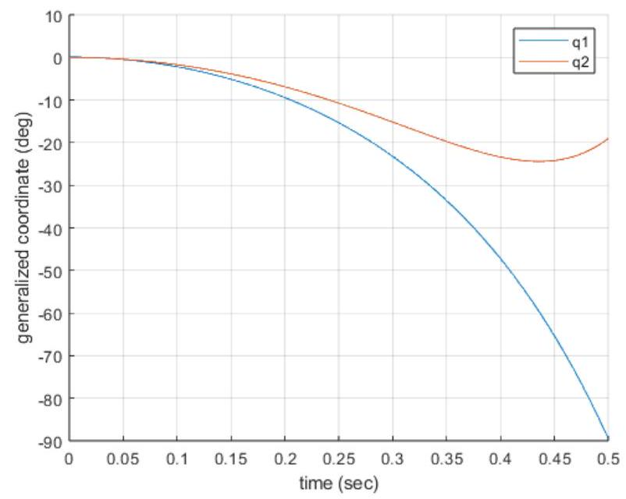
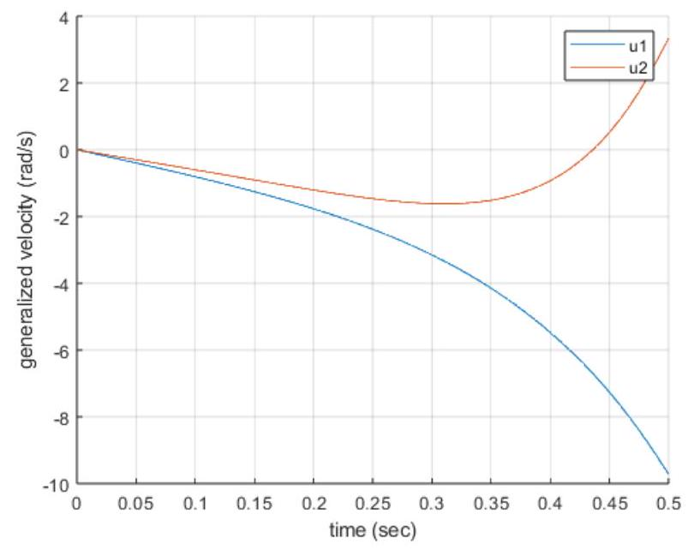
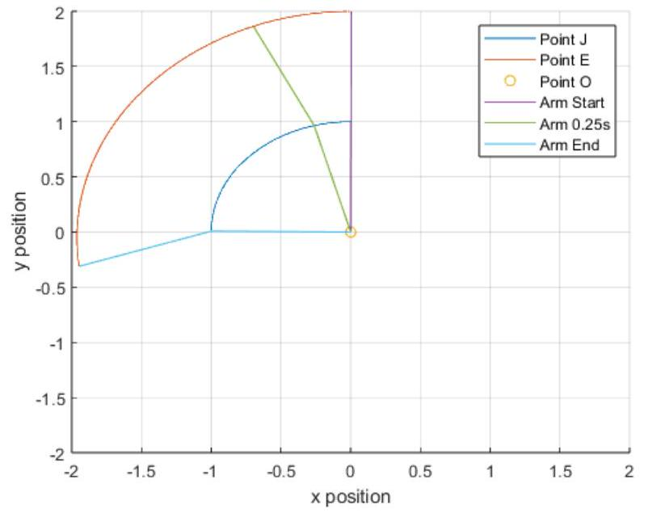
Results: Trial 1
Trial 1: T_{B}, T_{C} = -10 Nm
Notes:
At about the halfway point of the trial, both the generalized velocities and accelerations begin to diverge. Looking at the third figure – which is meant to show the movement of the two links in space, it’s clear to see that this is caused by the second link moving faster than the first, as the first link imparts its momentum on the second.

Slide 16
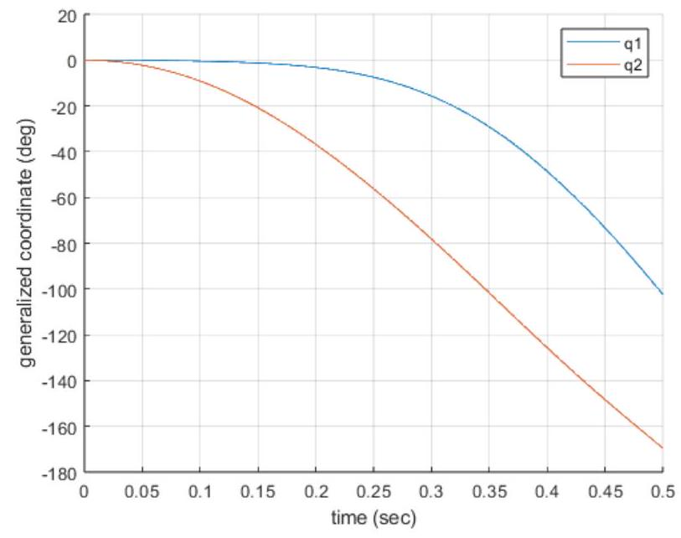
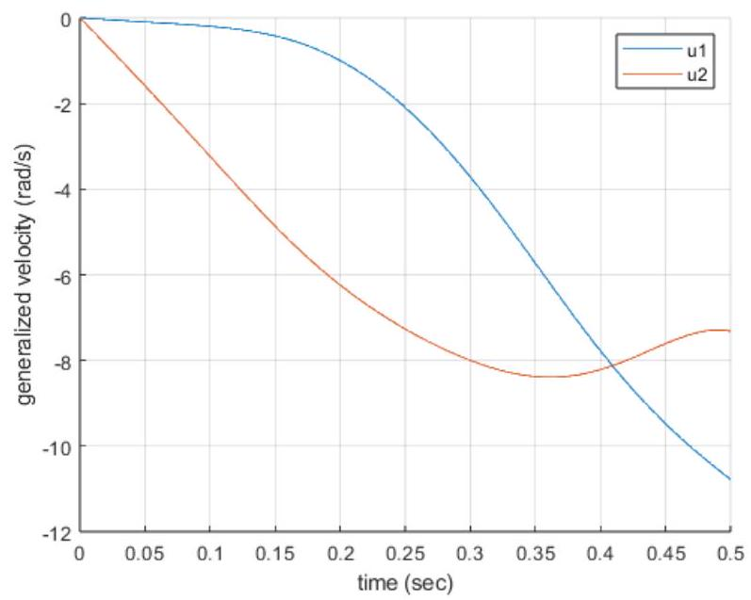
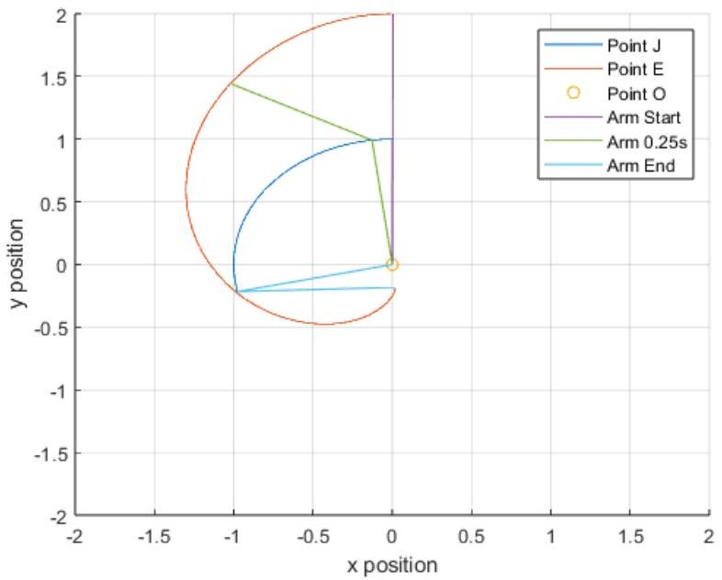
Results: Trial 2
Trial 2: T_{B} = -10 Nm, T_{C} = -20 Nm
Notes:
Increasing the torque on point J has some interesting results. Q2 and u2 decrease a lot faster than q1 and u1 and diverge almost immediately, which is evidenced point E reaching the bottom of its arc before the end of the simulation. This slowing down of the second link is visible in the curve of u2 as it crosses back over u1.

Slide 17
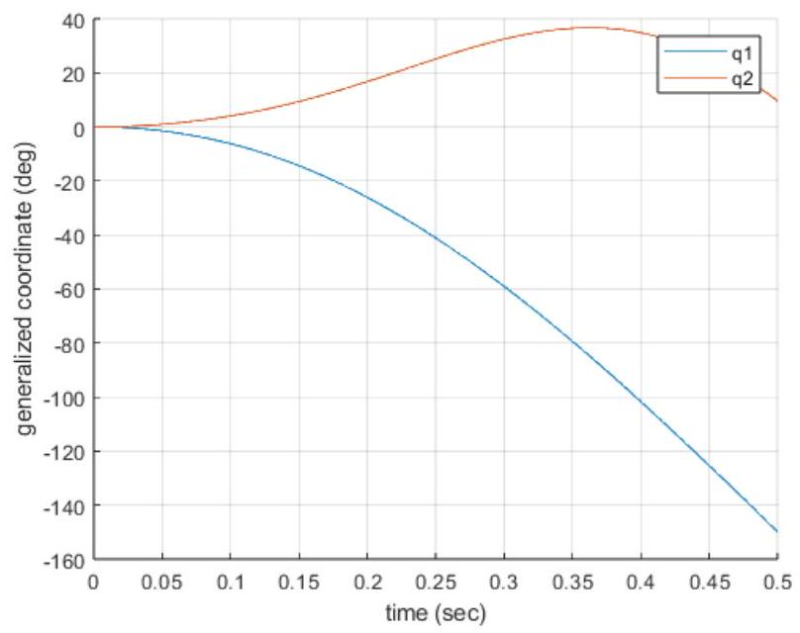
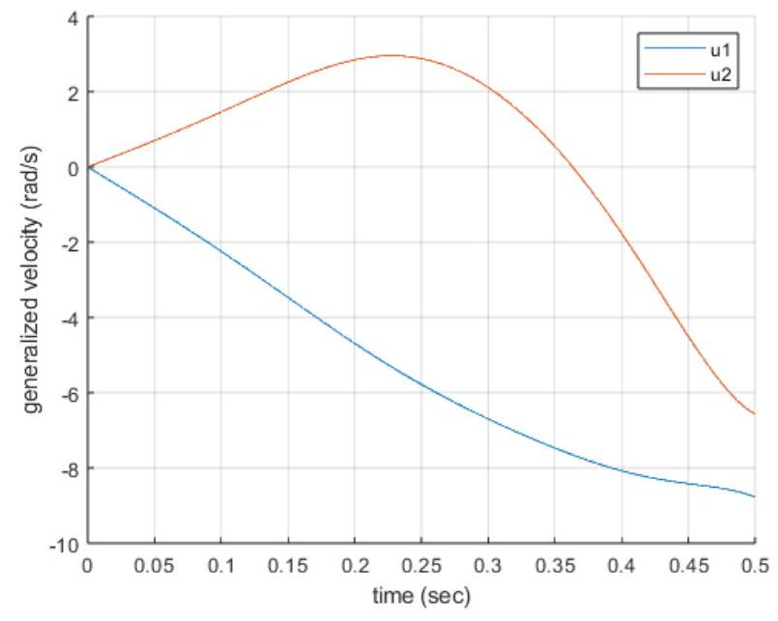
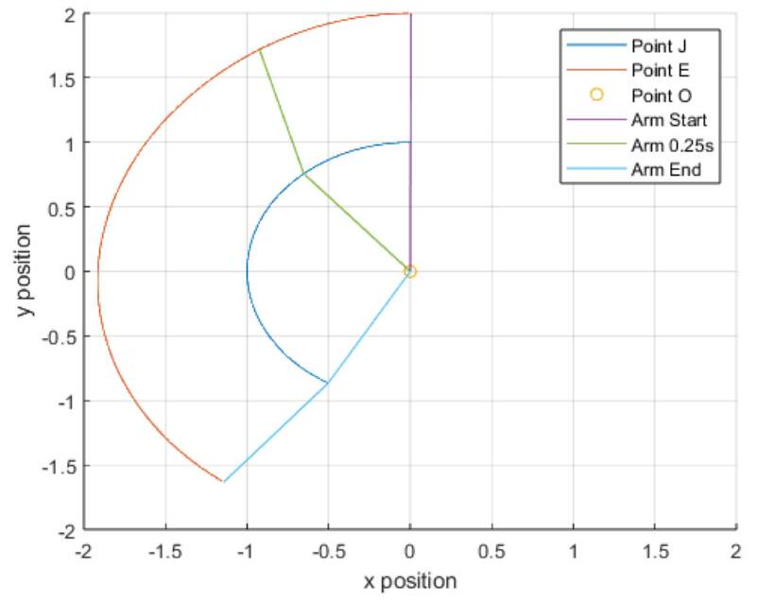
Results: Trial 3
Trial 3: T_{B} = -20 Nm, T_{C} = -10 Nm
Notes:
In the third trial, we note that u1 and u2 appear to begin to converge before the end of the simulation. In the third graph, we see that the second link starts behind the first and is catching up by the end of the simulation. This makes sense as less torque about J than O means the second link is not accelerating as much as the first.

Slide 18
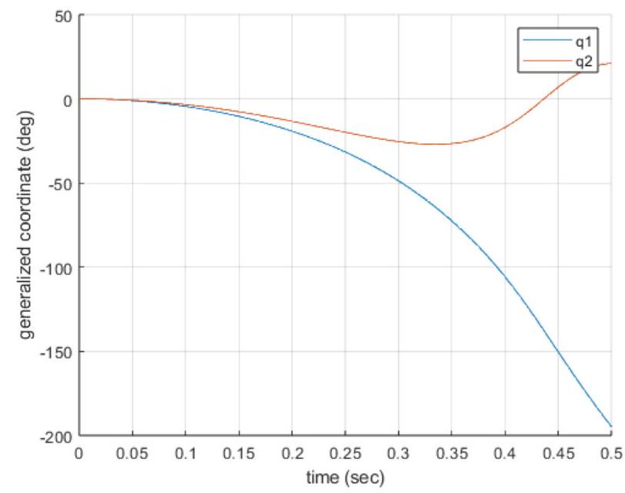
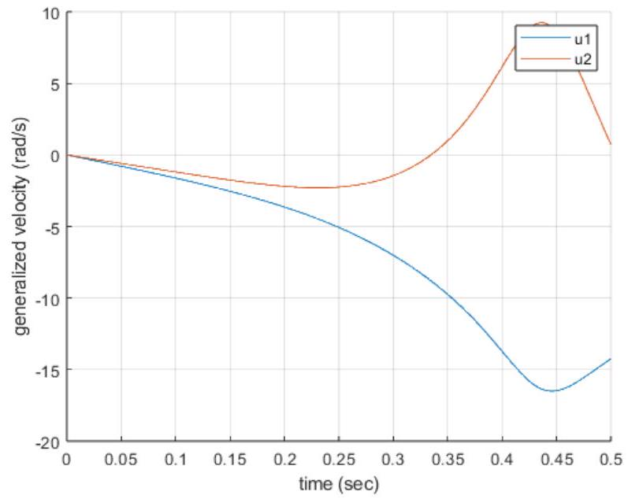
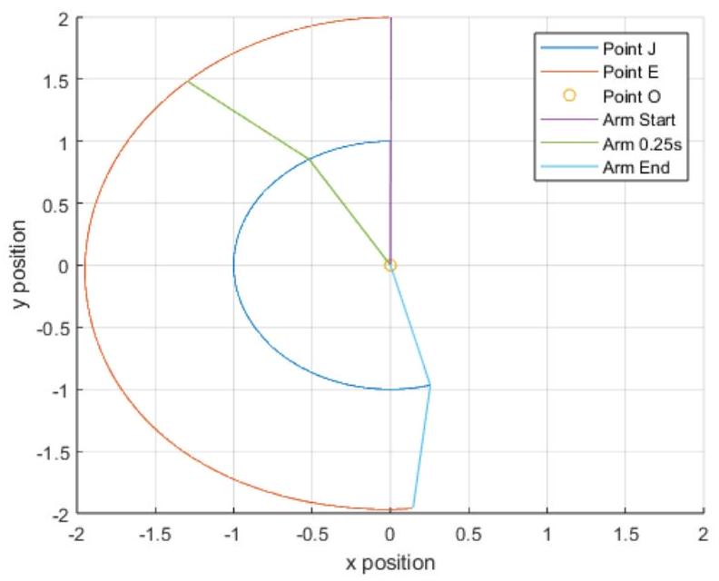
Results: Trial 4
Trial 4: T_{B}, T_{C} = -20 Nm
Notes:
Trial 4 is like a sped-up version of trial one as both joints have twice as much torque applied to them, though it’s worth remembering that gravity is still the same here. Still, we note some interesting trends such as the generalized velocities reaching a point where they stop diverging and appear to begin converging by the end of the simulation. We also note that the second link starts out moving faster than the first before falling behind.

Slide 19
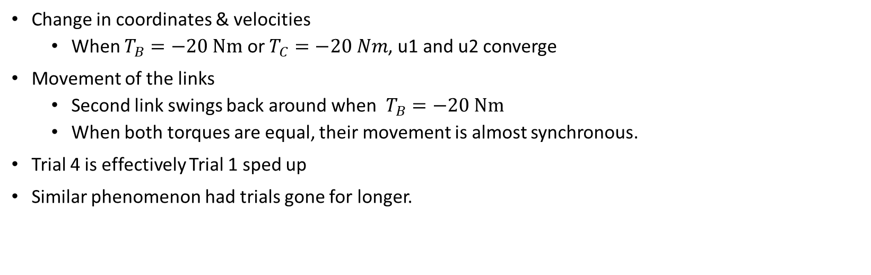
Results: Trials 1-4
Change in coordinates & velocities
When $T_{B}=−20 Nm$ or $T_{C}=−20 Nm$, u1 and u2 converge
Movement of the links
Second link swings back around when $T_{B}=−20 Nm$
When both torques are equal, their movement is almost synchronous.
Trial 4 is effectively Trial 1 sped up
Similar phenomenon had trials gone for longer.
Notes:
To recap, when the torque about either joint is -20 Nm, both generalized velocities will appear to start converging near the end of the simulation. When the torque about O is -20 Nm, link 2 falls behind the first which is more noticeable when the torque about J is -10 Nm. The implication here for pitching baseballs is that the torque about the second joint would likely need to be greater than the torque about the base joint. Finally, if each trial had gone on for longer, we would have likely begun to see similar phenomena in the motion of the arm that we saw in trial 4.

Slide 20
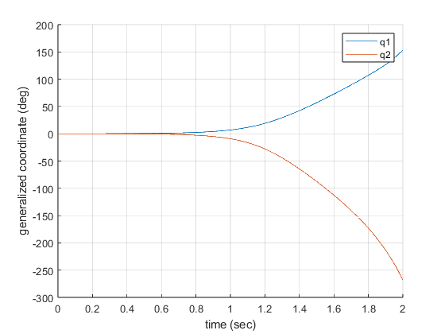
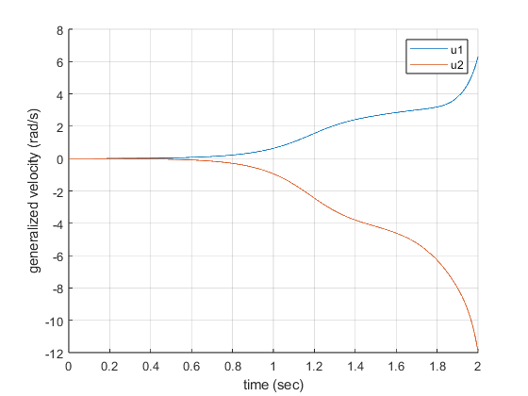
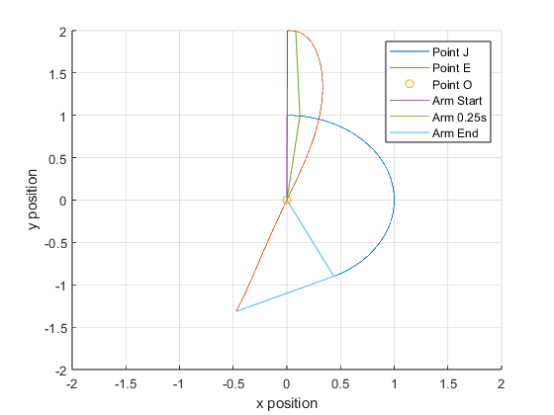
Results: Trial 5
Trial 5: T_{B}, T_{C} = 0 Nm
Notes:
We also did a trial where we did not apply any torque to the system as a control to better understand the underlying dynamics. We attempted to use the same set of initial conditions but ended up setting the angle q1 to 0.1 degrees so that the system would move and not just stand still. The simulation was also run for 2 seconds as the arm moved a lot slower without any torque applied.

Slide 21
Results: Trial 5
Generalized Coordinates and Velocities take much longer to diverge
Arm behaves more like a double pendulum
Insight into the link dynamics
Notes:
As seen, the generalized coordinates took a lot longer to diverge as the only external acceleration was due to gravity. In this situation, the arm behaves a lot more like a double pendulum, similar dynamics would probably appear in a longer simulation. A real arm would of course not behave like this due to joint constraints and friction. Nevertheless, this test provides a good insight into the dynamics of the two links.

Slide 22
Conclusion
Examined the kinematic attributes of a 2D, 2-link arm
Explored the possible motions of the arm with applied torques
Demonstrated how different torques could be used to provide the speeds needed for pitching
Will hopefully prompt further innovation for baseball pitching arms
Notes:
This project was an exploration of the kinematic attributes of a 2D, 2 link robot arm and its possible range of motion by varying the applied torques to each joint. This process demonstrates how a robot arm would potentially need to move to pitch a baseball. Of course, a fully realized arm in 3D would have different dynamics, but the fundamentals are there. It is our hope that this study will prompt further research into baseball pitching arms and serve as a reference point to understanding what the dynamics of such an arm might look like.

Slide 23
References
[1] Bauml, B, Wimbock, T and Hirzinger, G. “Kinematically
optimal catching a flying ball with a hand-arm system.”
2010 IEEE/RSJ International Conference on Intelligent
Robots and Systems: pp. 2592–2599. IEEE. DOI
10.1109/IROS.2010.5651175. Accessed 2024-01-30, URL
http://ieeexplore.ieee.org/document/5651175/.
[2] Asgari, Mohsen and Nikoobin, Amin. “Analysis of Optimal
Dynamic Manipulation for Robotic Manipulator Based
on Pontryagin’s Minimum Principle.” Vol. 45 No. 11 :
pp. 9159–9169. DOI 10.1007/s13369-020-04663-8. Accessed 2024-01-30, URL
[3] Asgari, Mohsen and Nikoobin, Amin. “A variational
approach to determination of maximum throwable
workspace of robotic manipulators in optimal
ball pitching motion.” Vol. 43 No. 10 : pp. 2378–
2391. DOI 10.1177/01423312211001694. Accessed
2024-01-30, URL http://journals.sagepub.com/doi/10.1177/
01423312211001694.
[4] Sharma, Kartik and Sekhon, Gianetan Singh. “Design
and development of an effective ball catching robotic
arm with 3DOF.” Proceedings of the Second International
Conference on Computational Science, Engineering
and Information Technology: pp. 770–777. ACM. DOI
10.1145/2393216.2393345. Accessed 2024-01-30, URL
https://dl.acm.org/doi/10.1145/2393216.2393345.
[5] Cigliano, Pierluigi, Lippiello, Vincenzo, Ruggiero, Fabio and
Siciliano, Bruno. “Robotic Ball Catching with an Eye-in-
Hand Single-Camera System.” Vol. 23 No. 5 : pp. 1657–
1671. DOI 10.1109/TCST.2014.2380175. Accessed 2024-
01-30, URL http://ieeexplore.ieee.org/document/7018920/.
[6] Mahil, Samia M. and Al-Durra, Ahmed. “Modeling analysis
and simulation of 2-DOF robotic manipulator.” 2016
IEEE 59th International Midwest Symposium on Circuits and Systems (MWSCAS): pp. 1–4. 2016. DOI 10.1109/MWSCAS. 2016.7870099.
[7] Faber, Herre, Van Soest, Arthur J. and Kistemaker, Dinant
A. “Inverse dynamics of mechanical multibody systems: An improved algorithm that ensures consistency between kinematics and external forces.” Vol. 13 No. 9 : p. e0204575. DOI10.1371/journal.pone.0204575. Accessed 2024-01-30, URL
https://dx.plos.org/10.1371/journal.pone.0204575.

Slide 24
Questions?
Thank you!

